Slide 1






International Islamic University Chittagong
Welcome To
RoboMars
Mars Rover Task Simulation
C231071 – Tanbir
C231075 – Joy
C231055 – Sourav
C231069 – Ahnaf

Slide 2


Introduction
RoboMars is a simulation of how a Mars rover manages
its daily mission tasks.Since the rover can only focus on one job at a time, it needs a fair and smart way to decide what to do next.
Our project shows this decision-making in a clear and visual way.It even adapts when all tasks seem equally important, choosing the quickest ones first.
RoboMars helps us understand how a rover stays efficient, organized, and mission-ready on the Red Planet.

Slide 3
objective
Understand Round Robin and SJF scheduling
Simulate rover task execution
Understand OS scheduling concepts in a
real-world context.
Analyze how priority and arrival time influence
CPU performance.

Slide 4
methodology
Research &
Design
Test Case
Edge Case
Input Form
Gantt Chart
Analysis Table
Wating Time
Turn Around Time
Average
Task
Modeling
Implementation of
Algorithm
Validation
&
Testing
Visualization &
Interactivety
Performance Analysis
Task Info
Task Name
Round Robin
Shortest Job First
Technology &
Implementation
Strategy
HTML , CSS
Javascriopt
ReactJs

Slide 5
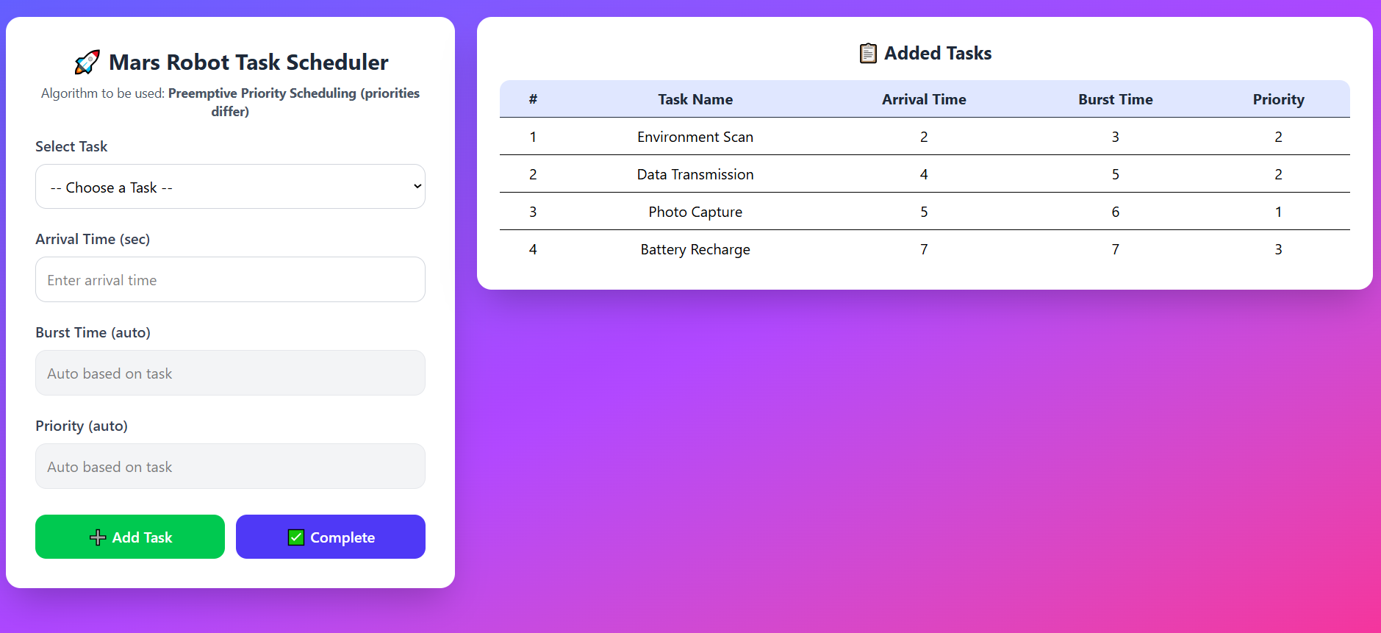
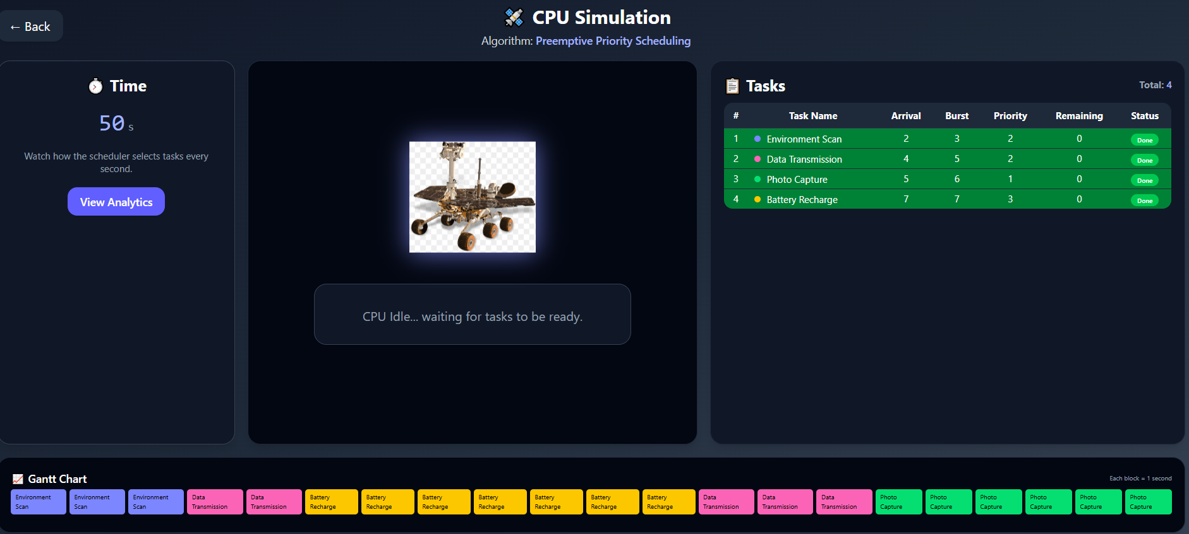
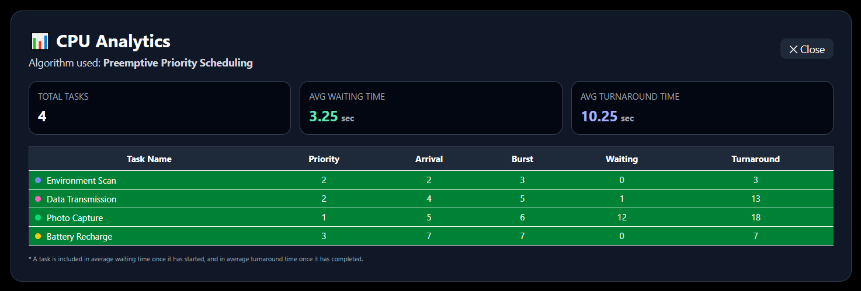
result
Input
Simulation
Analysis

Slide 6
Limitation’s
Manual task input required
Limited number of scheduling algorithms tested
Simulation-based (not real hardware execution)
Fixed time quantum configuration
Performance depends on user-defined inputs

Slide 7
conclusion
RoboMars successfully demonstrates how a Mars rover can manage multiple mission tasks efficiently.Through interactive simulation and visualization, the project helps in understanding CPU scheduling behavior and its impact on system performance.
Overall, the project bridges operating system concepts with real-world space mission scenarios in a simple and effective way.

Slide 8
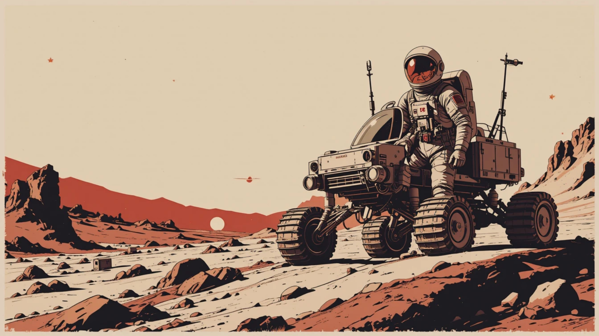

THANK YOU
FOR YOUR ATTENTION

